Slide 1
CSE 465 Lecture 7
CNN Architectures

Slide 2
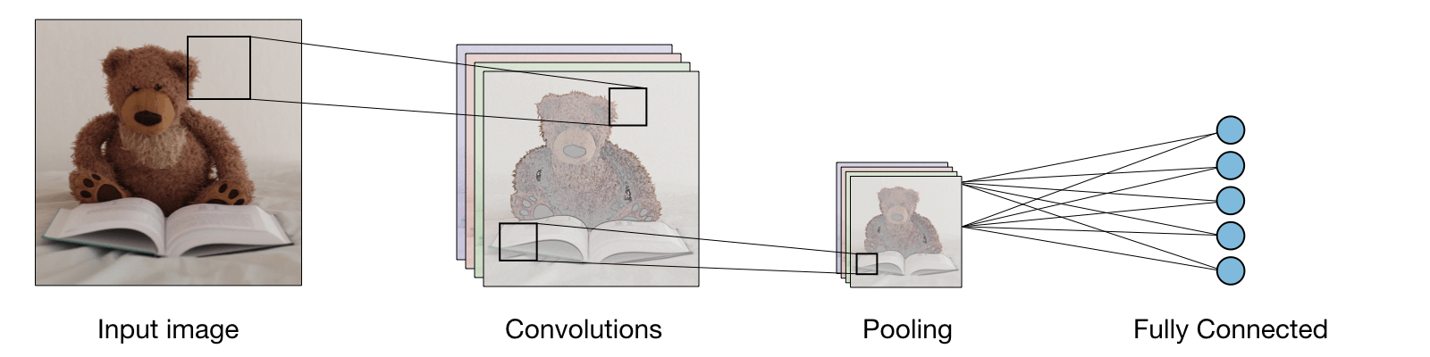
Review of CNN

Slide 3
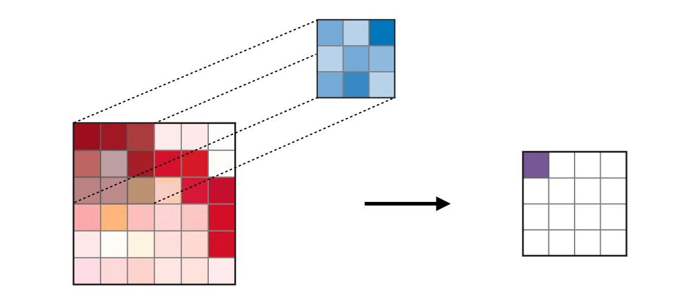
CNN – Types of Layer
Convolution layer (CONV) ― The convolution layer (CONV) uses filters that perform convolution operations as it is scanning the input with respect to its dimensions. Its hyperparameters include the filter size F and stride S. The resulting output O is called feature map or activation map.

Slide 4
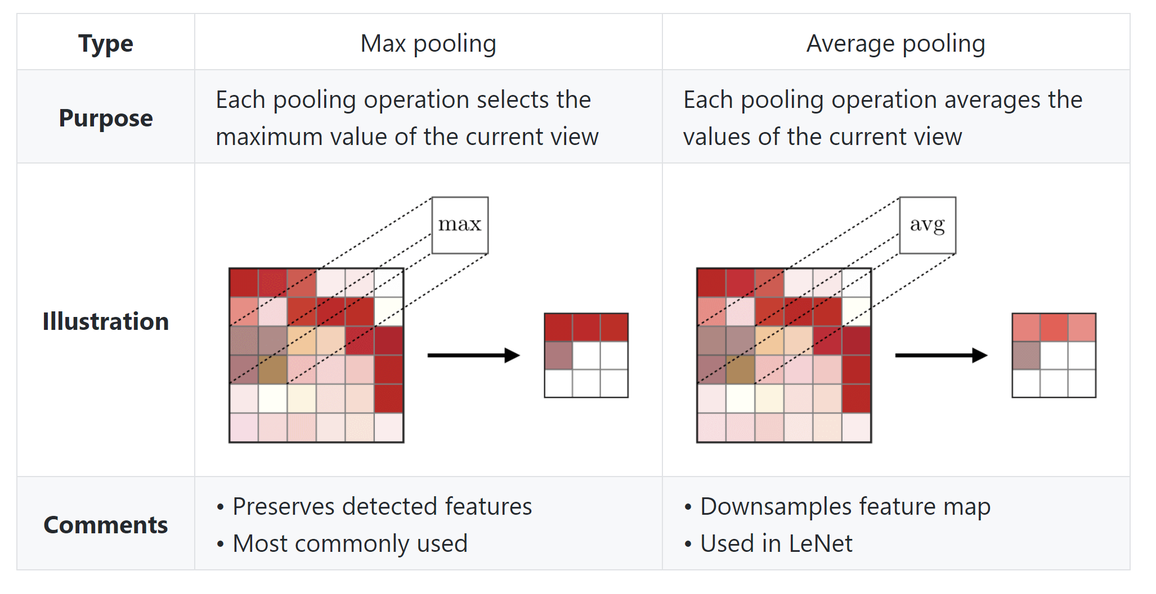
Types of Layer: Pooling
Pooling (POOL) ― The pooling layer (POOL) is a down sampling operation, typically applied after a convolution layer, which does some spatial invariance. In particular, max and average pooling are special kinds of pooling where the maximum and average value is taken, respectively.

Slide 5
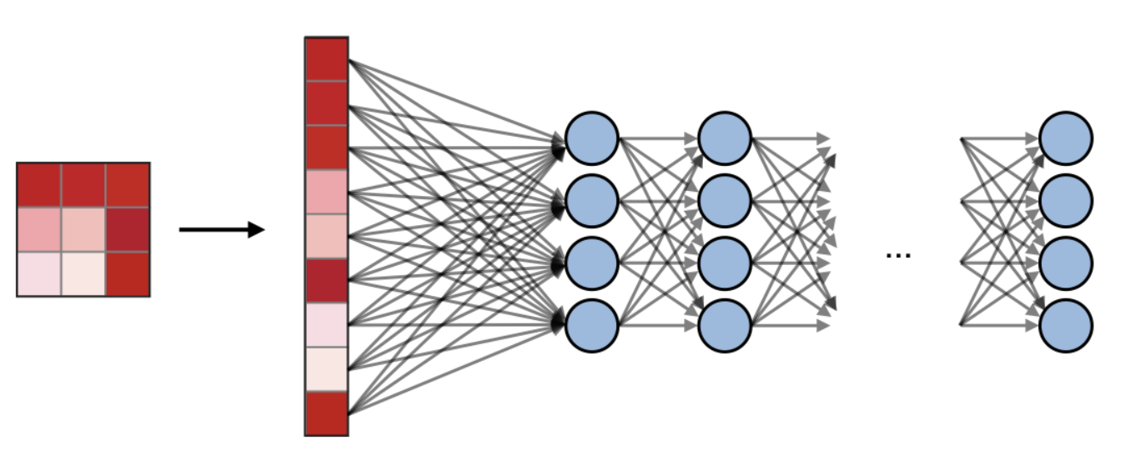
Types of Layer: FC
Fully Connected (FC) ― The fully connected layer (FC) operates on a flattened input where each input is connected to all neurons. If present, FC layers are usually found towards the end of CNN architectures and can be used to optimize objectives such as class scores.

Slide 6
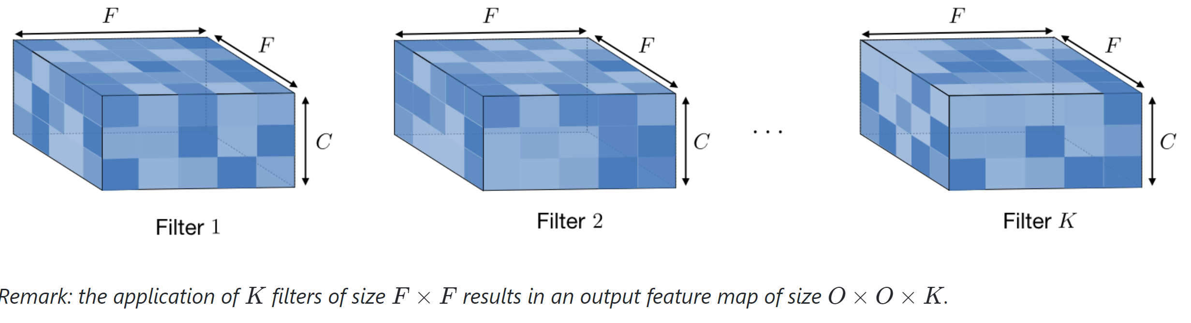
Filter Hyperparameters
Dimensions of a filter ― A filter of size F× F applied to an input containing C channels is a F×F×C volume that performs convolutions on an input of size I×I×C and produces an output feature map (also called activation map) of size O×O×1.

Slide 7
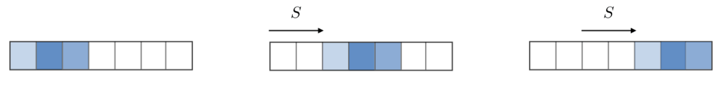
Filter hyperparameters: stride
Stride ― For a convolutional or a pooling operation, the stride SS denotes the number of pixels by which the window moves after each operation.

Slide 8
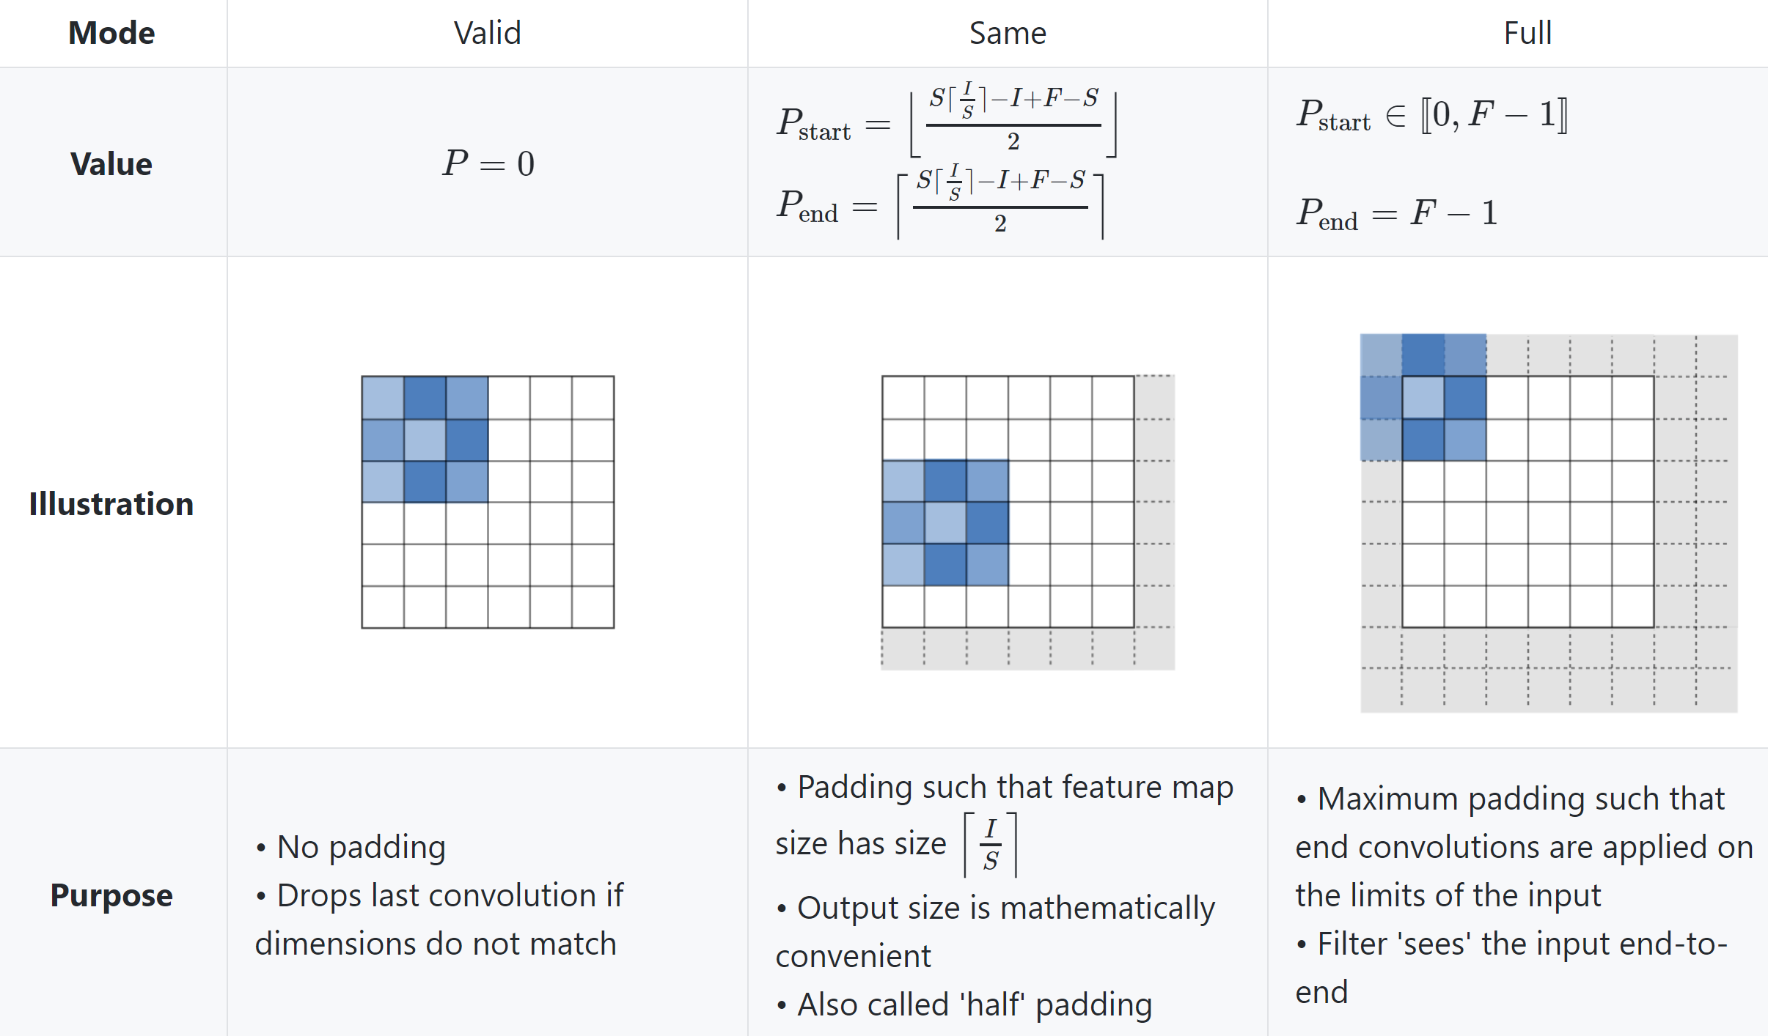
Filter hyperparameters: padding
Zero-padding ― Zero-padding denotes the process of adding P zeroes to each side of the boundaries of the input. This value can either be manually specified or automatically set through one of the three modes detailed below:

Slide 9
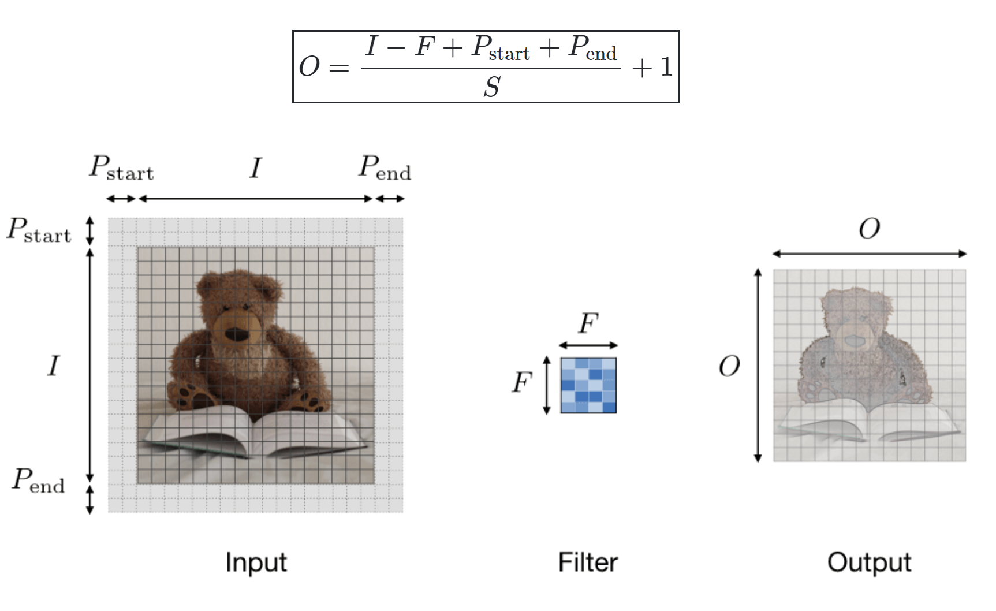
Tuning Hyperparameters
Parameter compatibility in convolution layer ― By noting II the length of the input volume size, FF the length of the filter, PP the amount of zero padding, SS the stride, then the output size OO of the feature map along that dimension is given by:

Slide 10
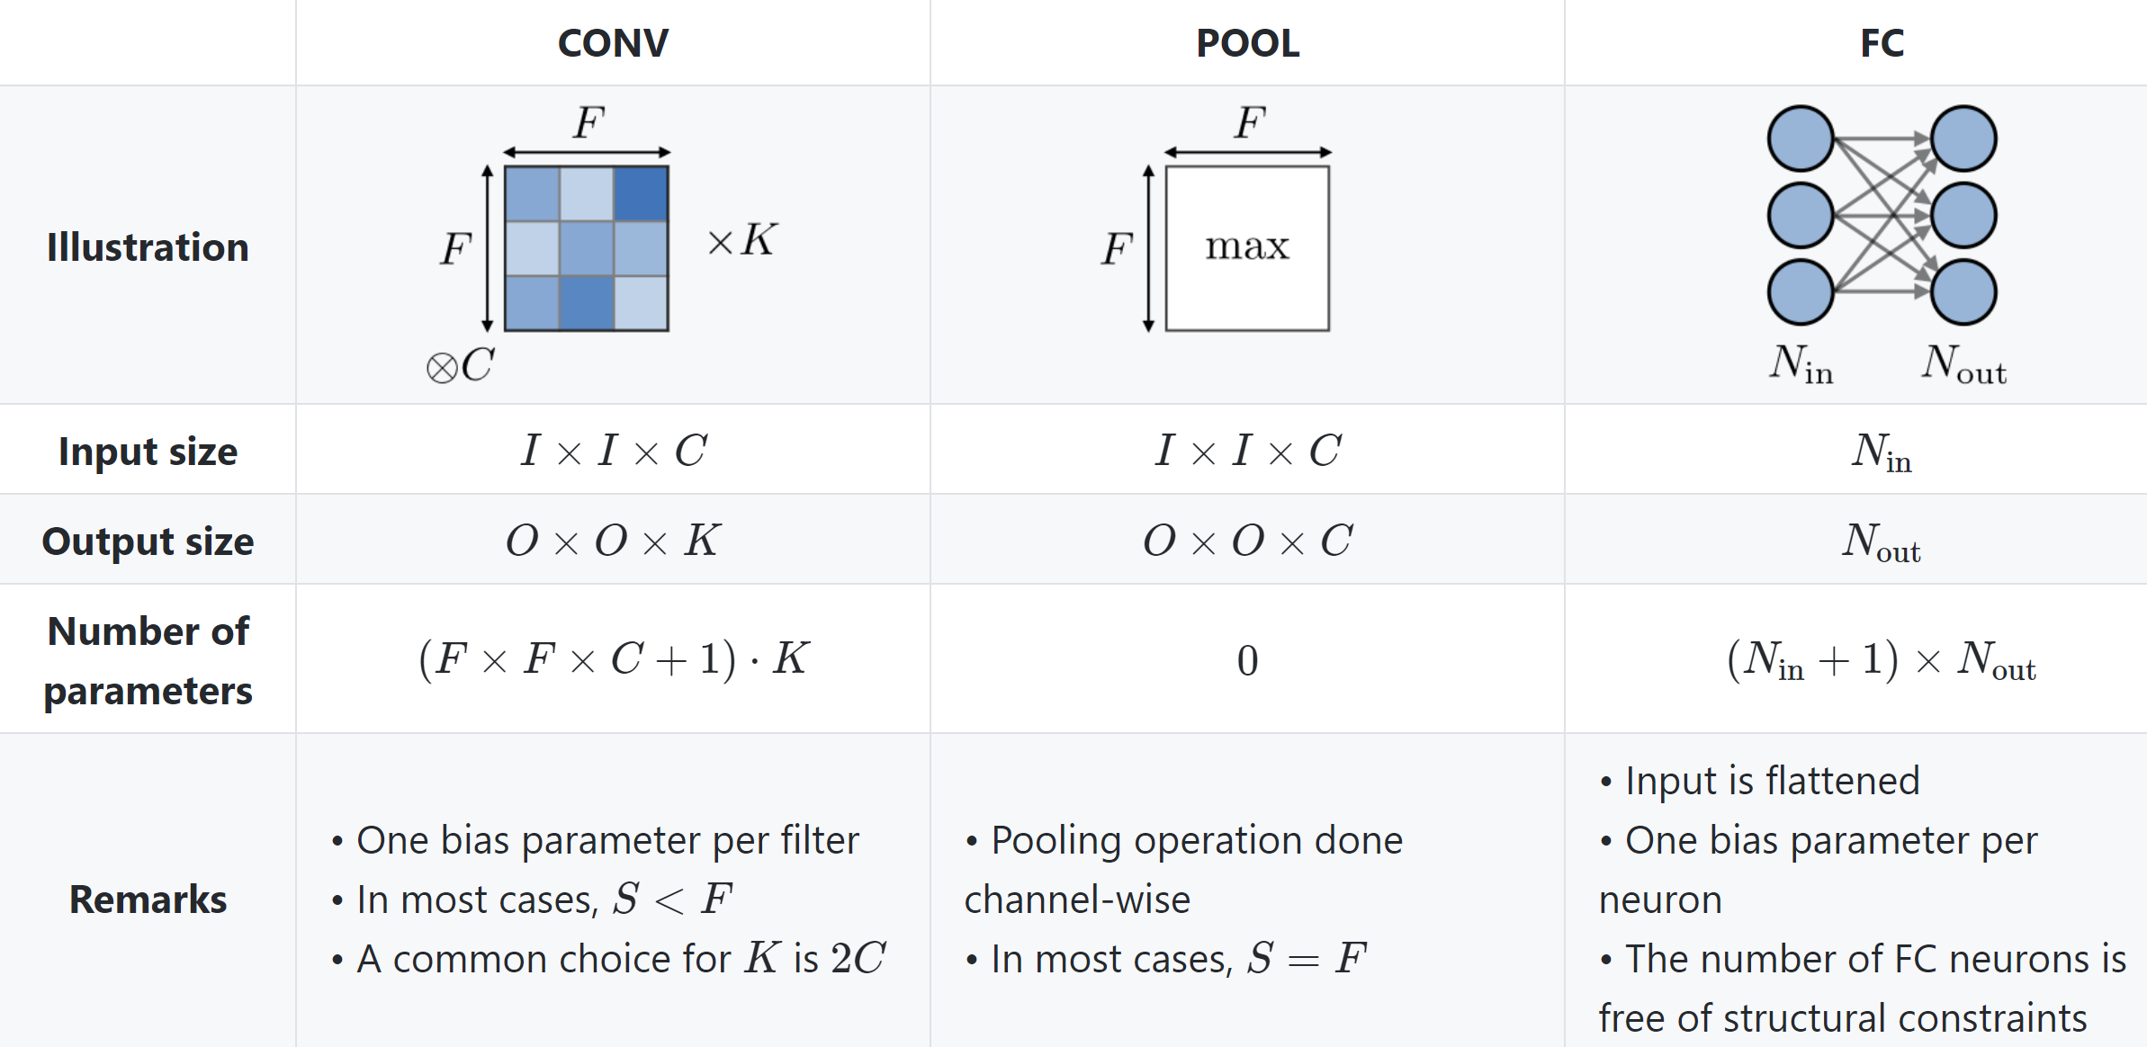
Complexity of the model
Understanding the complexity of the model ― In order to assess the complexity of a model, it is often useful to determine the number of parameters that its architecture will have. In each layer of a convolutional neural network, it is done as follows:

Slide 11
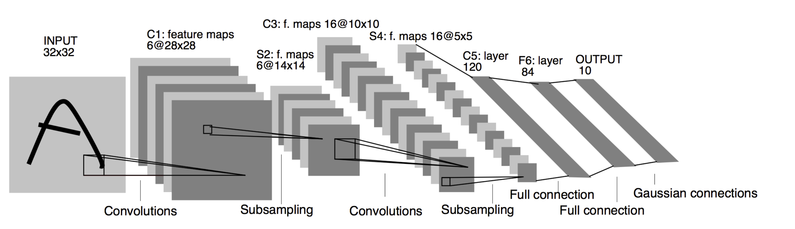
LeNet-5 (1998)

Slide 12
LeNet-5
By modern standards, LeNet-5 is a very simple network
It only has 7 layers
2 convolutional layers (C1, C3)
2 sub-sampling (pooling) layers (S2 and S4)
2 fully connected layer (F6) followed by the output layer
Convolutional layers use 5 by 5 convolutions with stride 1
Sub-sampling layers are 2 by 2 average pooling layers
Tanh sigmoid activations are used throughout the network

Slide 13
LeNet-5
Individual convolutional kernels in the layer C3 do not use all the features produced by the layer S2, which is very unusual by today’s standard
Reason for that is to make the network less computationally demanding
Another reason was to make convolutional kernels learn different patterns. This makes perfect sense: if different kernels receive different inputs, they will learn different patterns
LeNet-5 was able to achieve error rate below 1% on the MNIST data set, which was very close to the state of the art at the time
Around 60K parameters

Slide 14
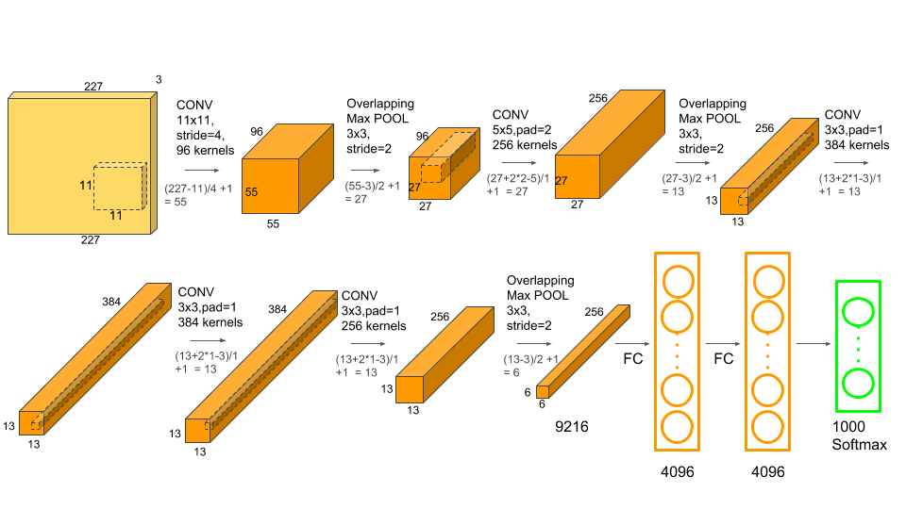
AlexNet
It contains 5 convolutional layers and 3 fully connected layers
The network has 62.3 million parameters, and needs 1.1 billion computation units in a forward pass

Slide 15
In AlexNet convolution layers accounts for 6% of all the parameters consumes 95% of the computation. The main features of AlexNet are
Copy convolution layers into different GPUs; Distribute the fully connected layers into different GPUs.
Feed one batch of training data into convolution layers for every GPU (Data Parallel).
Feed the results of convolution layers into the distributed fully connected layers batch by batch (Model Parallel) When the last step is done for every GPU. Backpropogate gradients batch by batch and synchronize the weights of the convolution layers.
Obviously, it takes advantage of the features: convolution layers have a few parameters and lots of computation, fully connected layers are just the opposite.

Slide 16
AlexNet Interesting Features
They first used ReLU
Used normalization layers
Heavy data augmentation
Dropout ratio 0.5
Batch size 128
SGD momentum 0.9
Learning rate 1e-2 – reduced manually by 10

Slide 17
AlexNet Conclusion
AlexNet famously won the 2012 ImageNet ILSVRC-2012 competition by a large margin (15.3% VS 26.2% (second place) error rates)
The network takes 90 epochs in five or six days to train on two GTX 580 GPUs
SGD with learning rate 0.01, momentum 0.9 and weight decay 0.0005 was used
Learning rate was divided by 10 once the accuracy plateaus
Bigger network than the LeNet-5
Unlike LeNet-5 they used ReLU
Basically used GPU to improve the performance

Slide 18
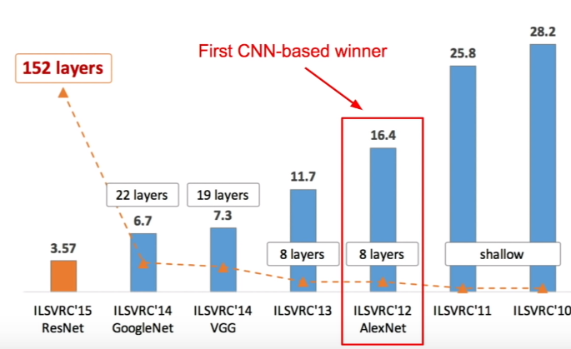
ImageNet Large Scale Visual Recognition Challenge (ILSVRC)

Slide 19
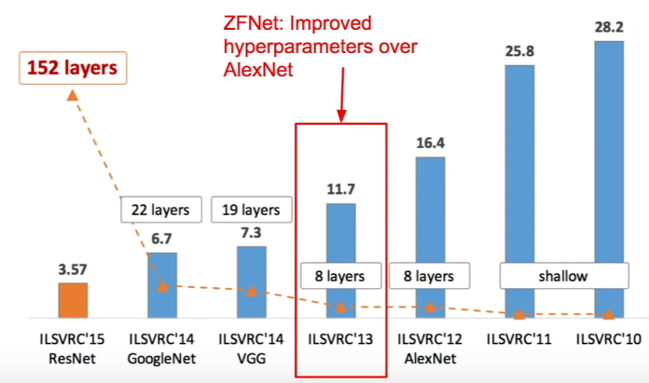
ImageNet Large Scale Visual Recognition Challenge (ILSVRC)

Slide 20
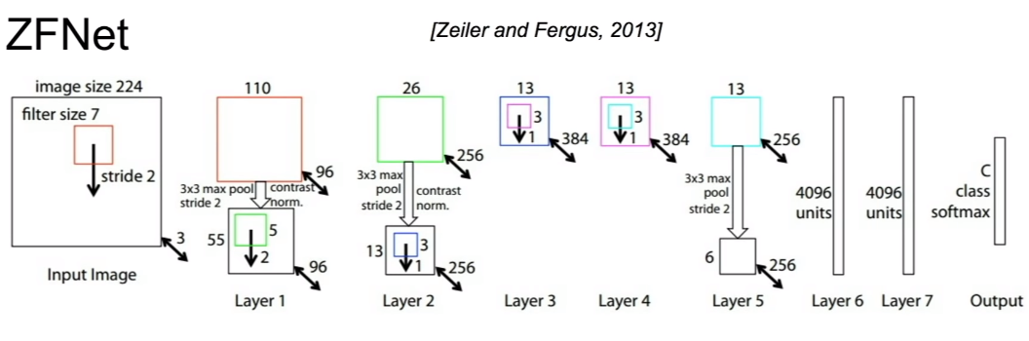
ZFNet
Almost AlexNet – changing hyperparameters
Conv1: Changes from 11X11 stride 4 to 7X7 stride 2
Conv3,4,5: Instead of 384, 384, 256 filters use 512, 1024, 512

Slide 21
VGG-XX
According to the universal approximation theorem, given enough capacity, we know that a feedforward network with a single layer is sufficient to represent any function
However, the layer might be massive and the network is prone to over-fitting the data
Therefore, there is a common trend in the research community that our network architecture needs to go deeper
Since AlexNet, the state-of-the-art CNN architecture is going deeper and deeper
While AlexNet had only 5 convolution layers, the VGG network has more than 16 layers

Slide 22
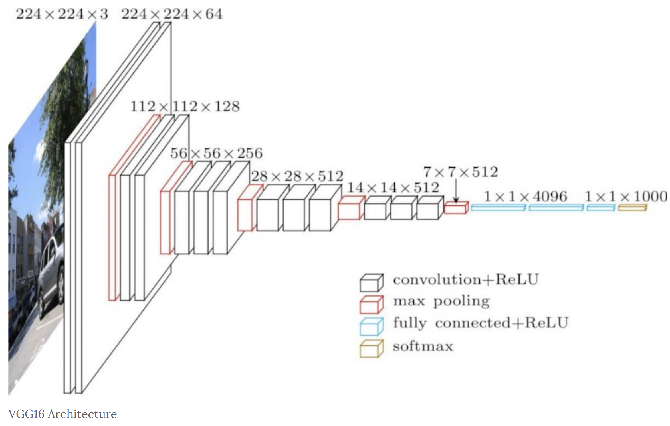
VGG-16

Slide 23
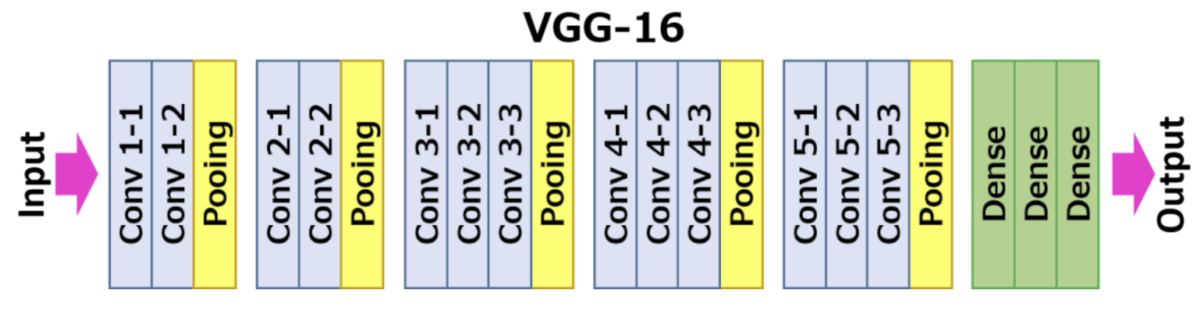
Improvement over AlexNet by replacing large kernel-sized filters (11 and 5 in the first and second convolutional layer, respectively) with multiple 3×3 kernel-sized filters one after another. VGG16 was trained for weeks and was using NVIDIA Titan Black GPU’s.

Slide 24
VGG-16
The input to cov1 layer is of fixed size 224 x 224 RGB image. The image is passed through a stack of convolutional layers, where the filters were used with a very small receptive field: 3×3 (which is the smallest size to capture the notion of left/right, up/down, center).
The convolution stride is fixed to 1 pixel
Padding was used to keep the image size fixed i.e. the padding is 1-pixel for 3×3 convolution layers
Spatial pooling is carried out by five max-pooling layers, which follow some of the conv. layers (not all the conv. layers are followed by max-pooling). Max-pooling is performed over a 2×2 pixel window, with stride 2.

Slide 25
VGG-16
Three Fully-Connected (FC) layers follow a stack of convolutional layers (which has a different depth in different architectures)
The first two have 4096 channels each, the third performs 1000-way ILSVRC classification and thus contains 1000 channels (one for each class)
The final layer is the soft-max layer. The configuration of the fully connected layers is the same in all networks.
All hidden layers are equipped with the rectification (ReLU) non-linearity
It is also noted that none of the networks (except for one) contain Local Response normalization (LRN), such normalization does not improve the performance on the ILSVRC dataset, but leads to increased memory consumption and computation time

Slide 26
VGG-16
Unfortunately, there are two major drawbacks with VGGNet:
It is painfully slow to train
The network architecture weights themselves are quite large (concerning disk/bandwidth)
Due to its depth and number of fully-connected nodes, VGG16 is over 533MB
There are 138 millions of parameters to learn

Slide 27
VGG improvements over AlexNet
Smaller filters (sometimes called kernels) reduce computations
More parameters
May learn better if we can take care of the overfitting problems
Somewhat modular
Need improvements? Use more blocks
However, increasing network depth does not work by simply stacking layers together
Deep networks are hard to train because of the notorious vanishing gradient problem — as the gradient is back-propagated to earlier layers, repeated multiplication may make the gradient infinitively small
As a result, as the network goes deeper, its performance gets saturated or even starts degrading rapidly

Slide 29
Observations until now
Choosing the right kernel size for convolution is always a big deal in CNNs
The same object can come in various sizes in different images
To capture the features of different sizes, we, of course, need to have kernel sizes accordingly
Bigger kernels are generally good when the object covers most of the area
Smaller kernels are suitable for relatively small objects
The deeper the network, the better it is! But stacking a lot of layers makes the gradient flow difficult and leads to overfitting
In short, the depth of a network is somewhat restricted to a certain limit – beyond this limit, the network is not trainable anymore; it just overfits

Slide 30
Observation until now
Some parts of the image can have extremely large variation in size
For instance, an image of a dog can be big, small, etc.
Even the same image can have dogs of different sizes
Because of this variation in the location/proportion of the information, choosing the right kernel size for the convolution operation becomes tough
A larger kernel is preferred for information that is covering a large part of the image
A smaller kernel is preferred for information that is covering smaller portion of an image
And Inception is born

Slide 31
Observation until now
Very deep networks are prone to overfitting
It also hard to pass gradient updates through the entire network
Naively stacking large convolution operations is computationally expensive
And here comes Resnet

Slide 33
Solution: Inception networks
The idea is to use different sizes for convolution kernels in parallel rather than using a single kernel size in a layer
This way, the network now has options in kernel sizes and the network can now learn features through the kernel that's best suited to the job
Arranging kernels parallel to each other also makes the architecture sparse, which helps to ease the training for deeper networks
The typical InceptionNet uses three convolution kernels of sizes 1 x 1, 3 x 3, and 5 x 5 simultaneously
The results from all these three kernels are concatenated to form a single output vector, which acts as the input for the next layer
The inception layer also adds 1 x 1 convolutions before the 3 x 3 and 5 x 5 kernels in order to reduce the size

Slide 34
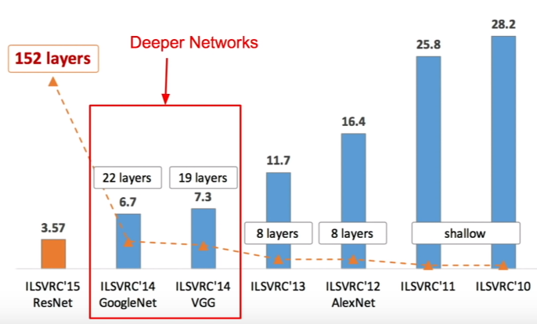
ImageNet Large Scale Visual Recognition Challenge (ILSVRC)

Slide 35
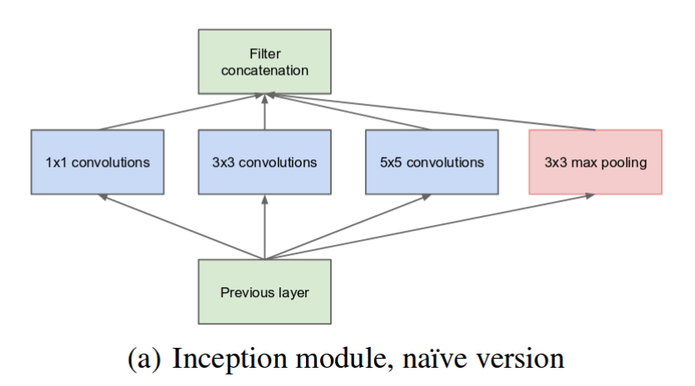
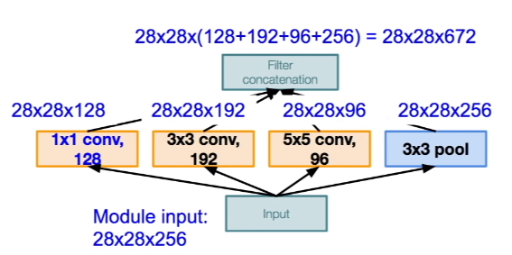
Inception Network (GoogleNet)

Slide 37
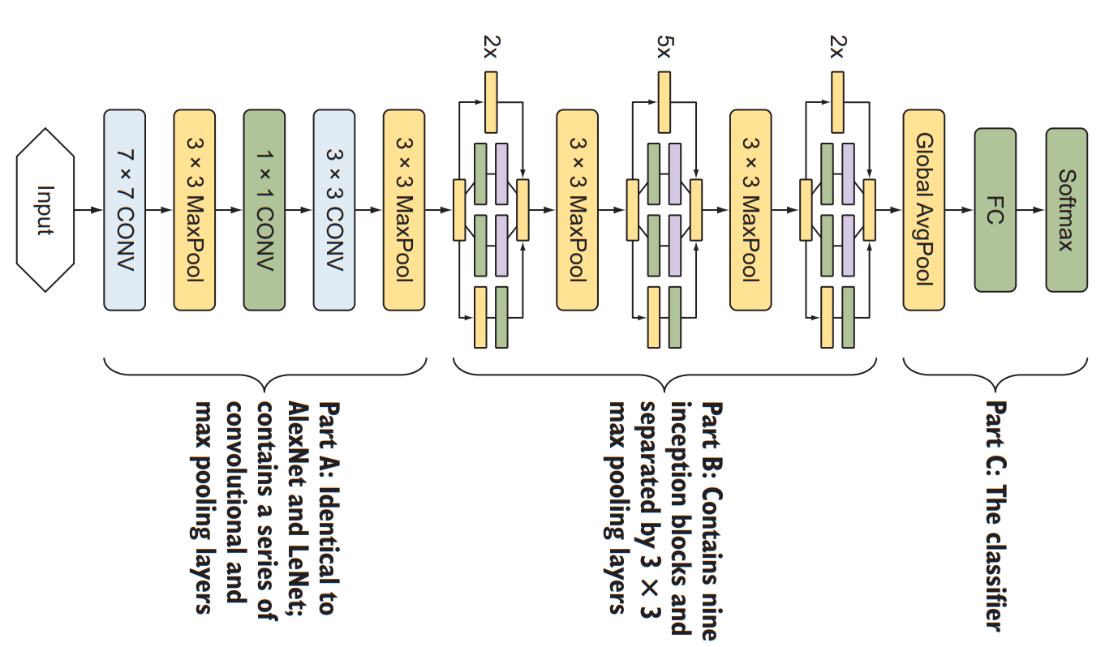
GoogleNet: The complete architecture

Slide 38
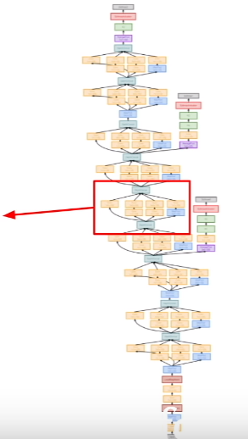
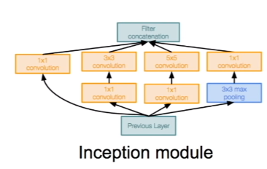
GoogleNet (collection of inception modules)

Slide 39
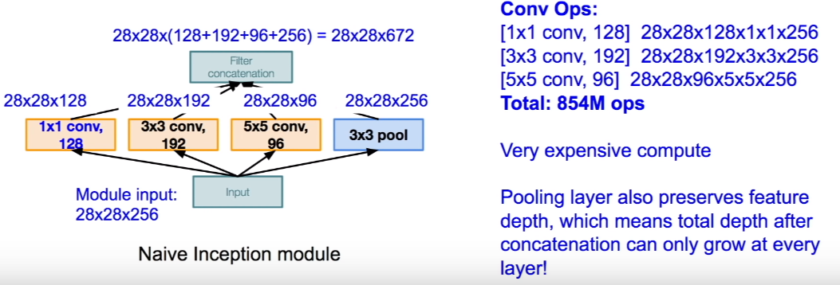
However… The computational complexity

Slide 40
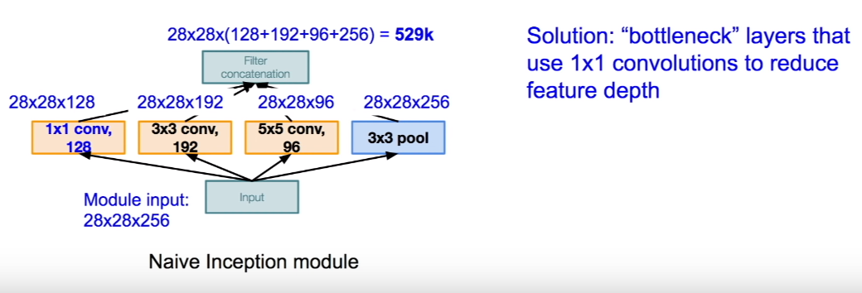
What do we do?

Slide 41
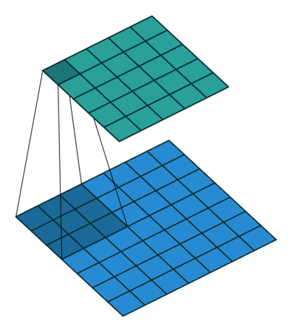
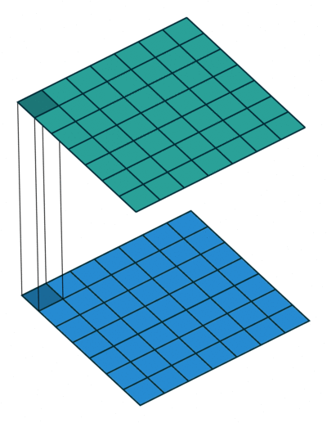
1X1 Convolution

Slide 42
Why 1X1 Convolution
Most simplistic explanation would be that 1x1 convolution leads to dimension reduction
For example, an image of 200 x 200 with 50 features on convolution with 20 filters of 1x1 would result in size of 200 x 200 x 20
Is this the best way to do dimensionality reduction in the convolutional neural network? What about the efficacy vs efficiency?

Slide 46
Why 1X1 Convolution
Although 1x1 convolution is a ‘feature pooling’ technique, there is more to it than just sum pooling of features across various channels/feature-maps of a given layer
1x1 convolution acts like coordinate-dependent transformation in the filter space
This transformation is strictly linear, but in most of application of 1x1 convolution is succeeded by a non-linear activation layer like ReLU
This transformation is learned through the (stochastic) gradient descent
An important distinction is that it suffers with less over-fitting due to smaller kernel size (1x1)

Slide 47
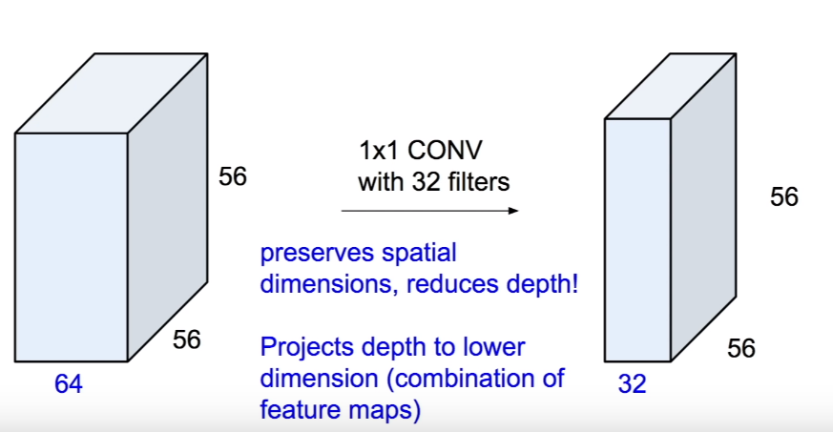
1X1 Convolution: reduces depth

Slide 48
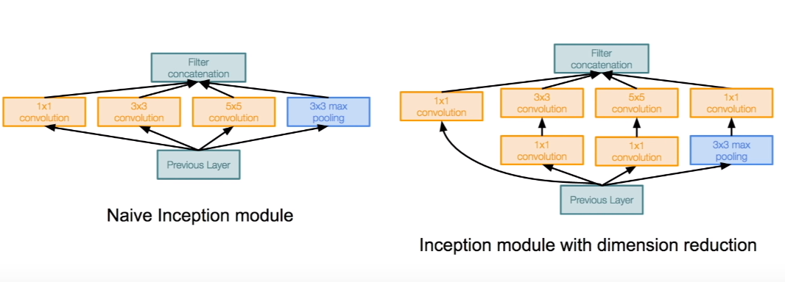
Computationally efficient inception modules

Slide 49
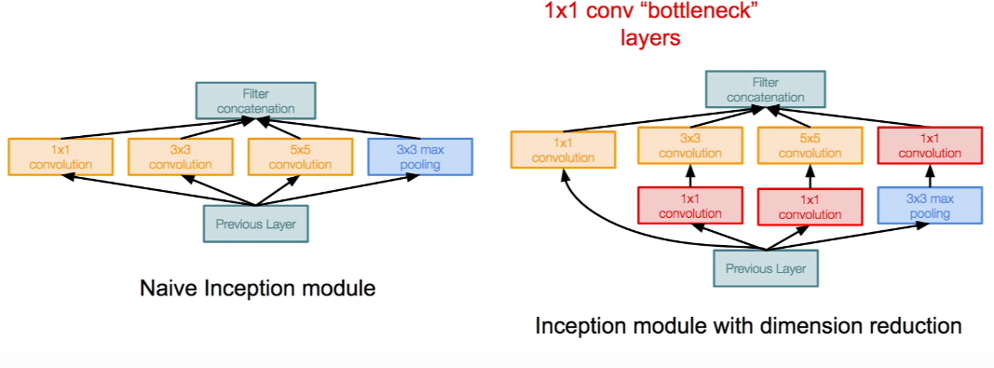
Computationally efficient inception modules

Slide 50
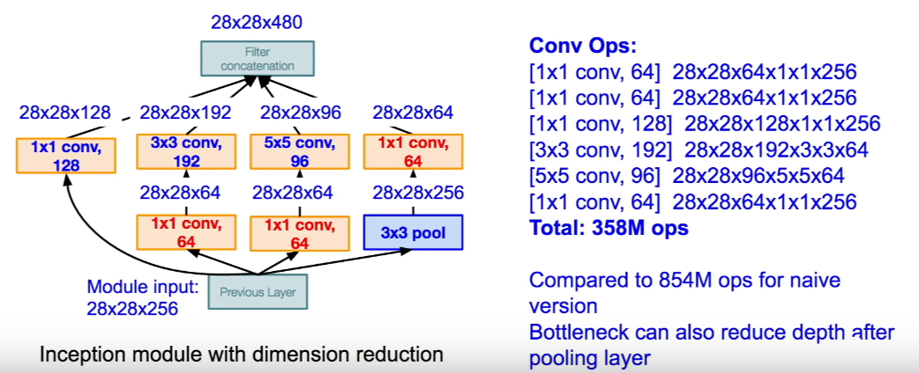
Computationally efficient inception modules The improvements

Slide 51
ResNet
ResNet exposes a problem that has been restricting the training of very deep networks
During the training of deep networks, the accuracy saturates to a certain limit and thereafter degrades rapidly
This phenomenon has been restricting the accuracy to a certain threshold, no matter how deep the architecture goes
ResNet was introduced by Microsoft research in a paper called, Deep Residual Learning for Image Recognition
This is the first network architecture that has successfully trained a network with a depth of more than 100 layers
What made this impossible possible?
Better weight initializations
New normalization layers
The skip-connections

Slide 52
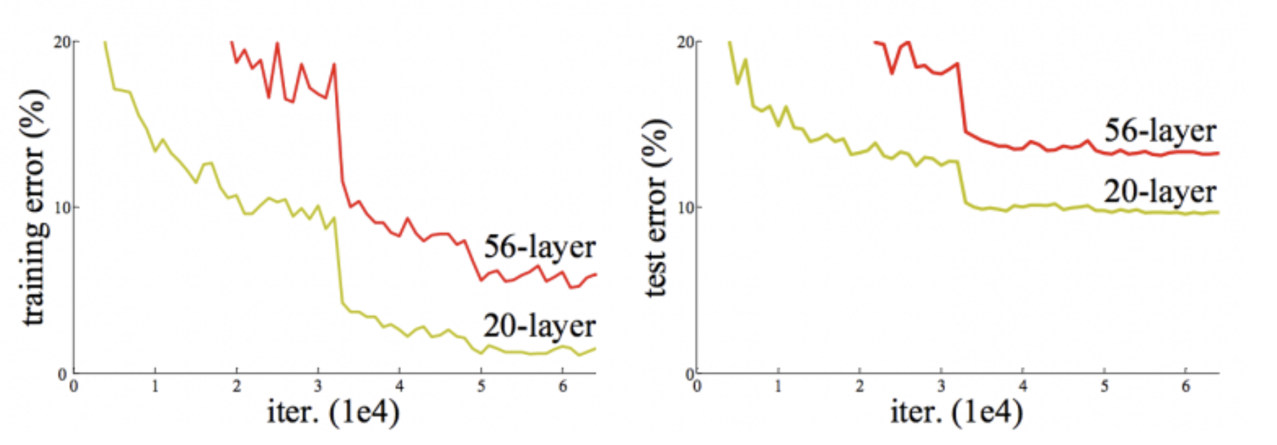
Why ResNet? 56/20 Layers
A group at Microsoft research were going deeper and deeper and found the following graph
Training & test error are lower (better) for a 20 layer network than a 56 layer network!!!
Overfitting is the problem
There was no good way to optimize the weights

Slide 53
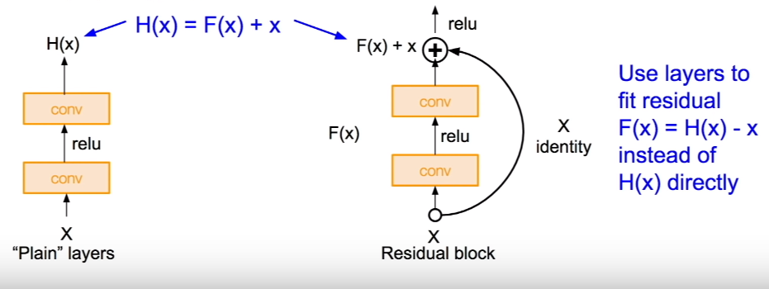
ResNet Concepts
Instead of making the network learn the mapping from x to y with a function (H(x) ), it uses a residual function F(x) = H(x) – x
It is easier to optimize the indirect residual function (F(x)) than it is to reach a direct optimized mapping H(x) from x to y
Here, Input x is to be added to the output from the layer in order to make the final output H(x) = F(x) + x
This kind of creates a connection from the input to the output of the layer, which is called the residual connection or skip connection

Slide 54
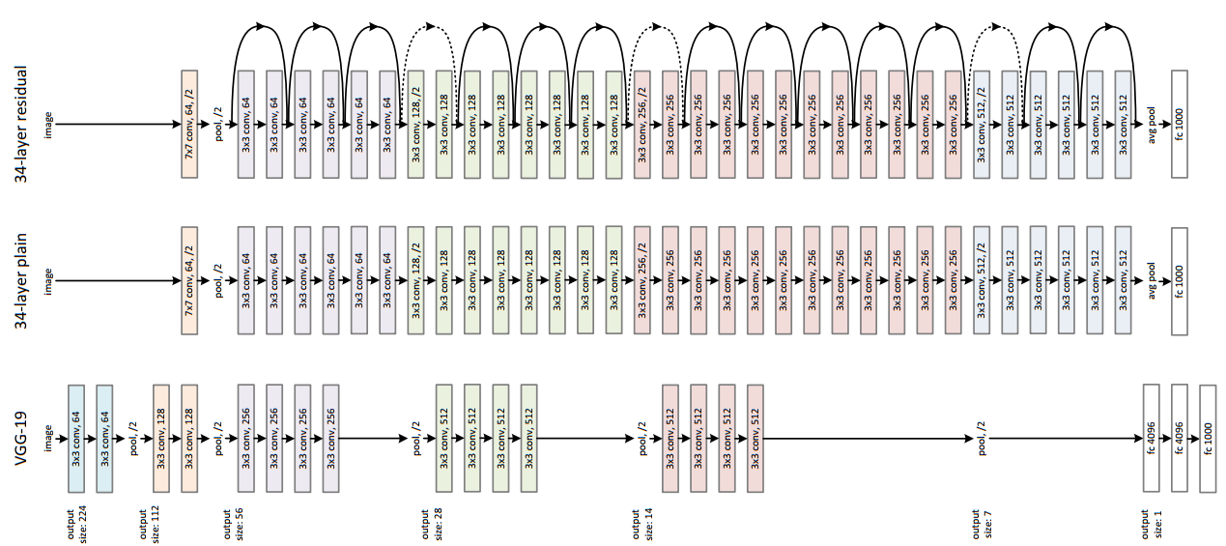
ResNet Actual Implementation

Slide 55
Why ResNet?
When the deeper network starts to converge, a degradation problem has been exposed: with the network depth increasing, accuracy gets saturated (which might be unsurprising) and then degrades rapidly
Such degradation is not caused by overfitting not by more layers
But because of the failure of the traditional optimization methods
Therefore, we add workarounds to propagate the information needed to optimize better
So, does ResNet solve the problem?
The next slide shows the improvements

Slide 56
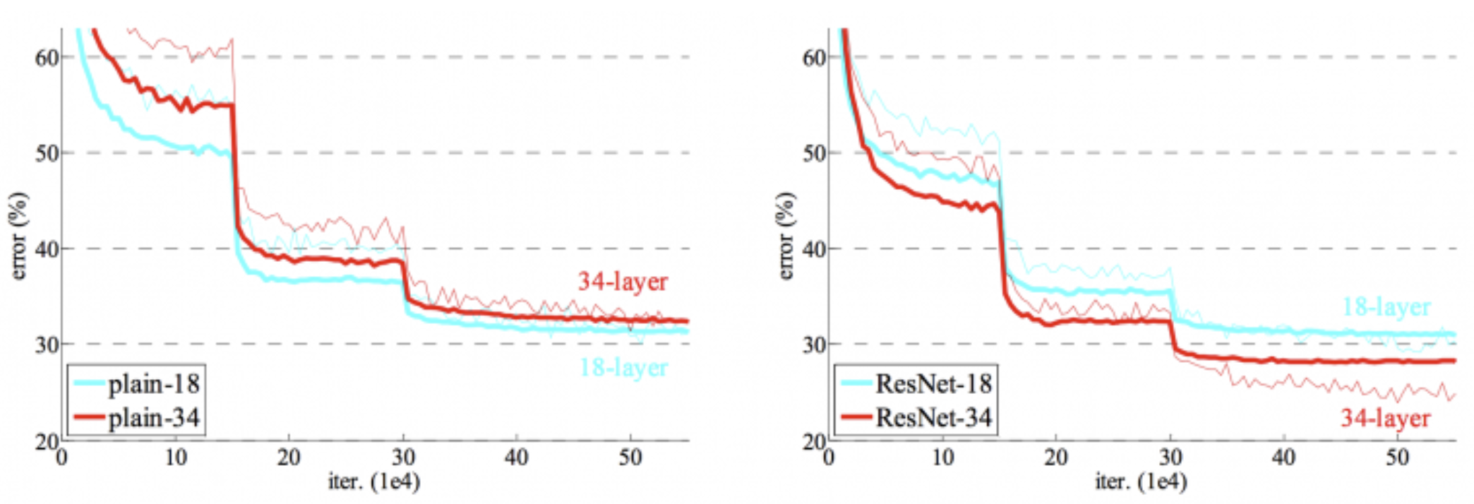
ResNet

Slide 57
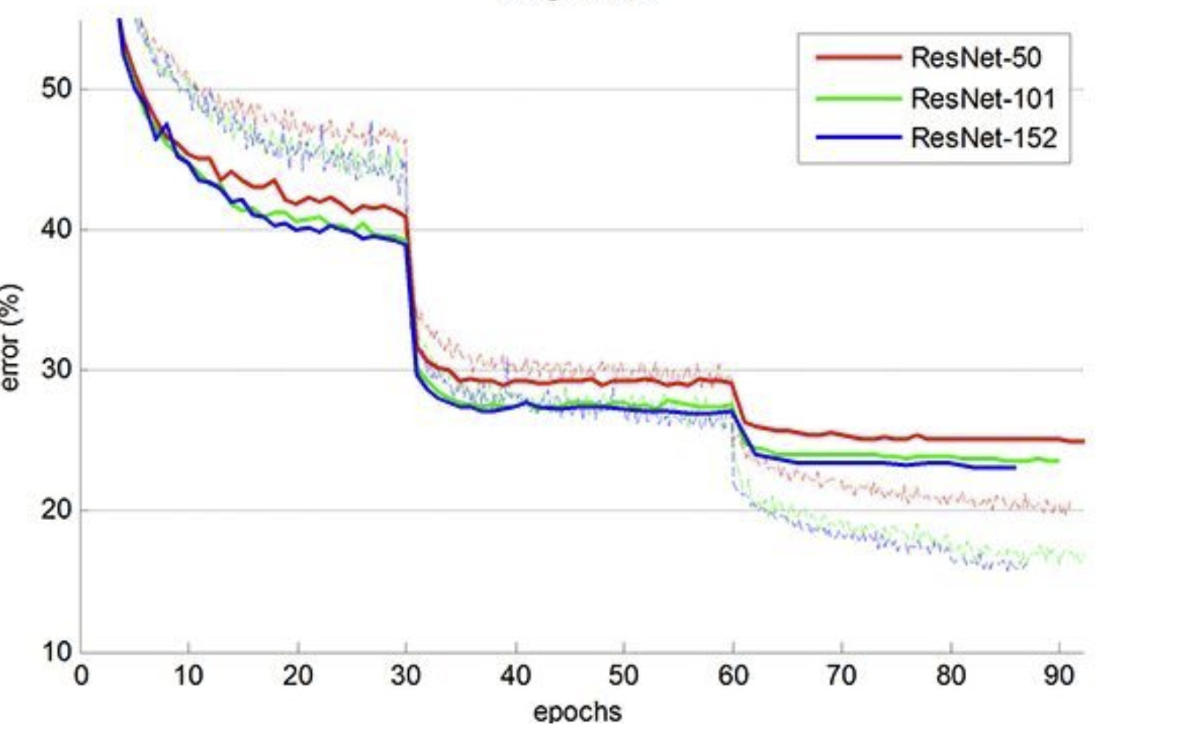
ResNet

Slide 58
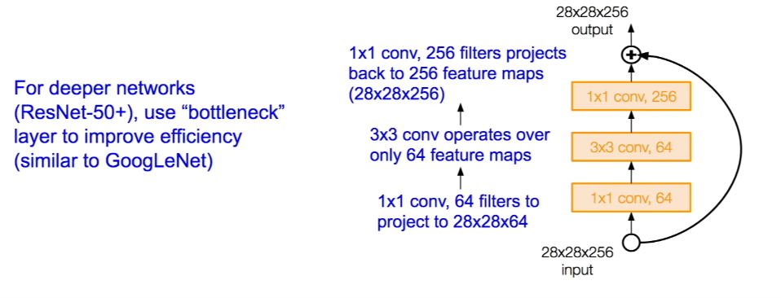
More optimizations

Slide 59
ResNet in practice
Batch normalization after every CONV layer
Xavier/2 initialization from He et al.
SGD + Momentum (0.9)
Learning rate: 0.1, divided by 10 when validation error plateaus
Mini-batch size 256
Weight decay of 1e-5
No dropout used

Slide 60
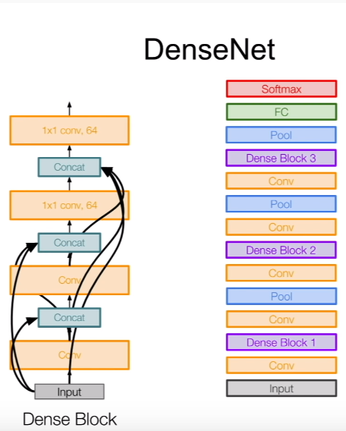
DenseNet
ResNet to the extreme
Every layer is connected with all the next layers

